Slide 1
Midterm Exam Solution - Accounting Principles
2022. 4.
Dr. Yangin Yoon

Slide 2
Asset vs. Expense – Example #1
ST Clean-House Consulting was established with $1,000 of cash on Dec. 1st, 2021. And there is no other event in 2021.
ST Clean-House Consulting did two sanitizing activities and earned $100 from each activity. They were paid by cash. And there is no other event in 2022.

Slide 3
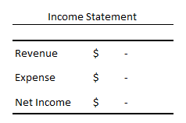
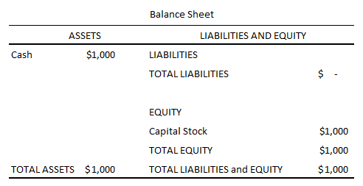
Asset vs. Expense – Example #1
ST Clean-House Consulting was established with $1,000 of cash on Dec. 1st, 2021. And there is no other event in 2021.
Accounting Records on Dec. 1st, 2021
Dec.1., 2021
Cash (asset) $1,000
Capital Stock(equity) $1,000

Slide 4
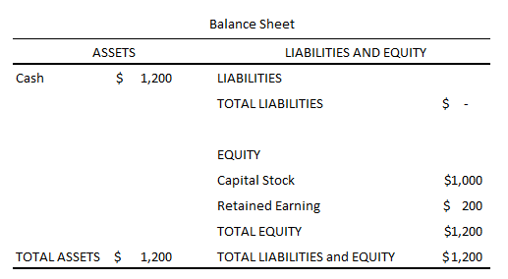
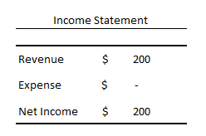
Asset vs. Expense – Example #1
ST Clean-House Consulting did two sanitizing activities and earned $100 from each activity. They were paid by cash. And there is no other event in 2022.
May.1., 2022
Cash (asset) $100
Main Revenue (revenue) $100
June.1., 2022
Cash (asset) $100
Main Revenue (revenue) $100

Slide 5
Asset vs. Expense – Example #2
ST Clean-House Consulting was established with $1,000 of cash on Dec. 1st, 2021. And there is no other event in 2021.
ST Clean-House Consulting did two sanitizing activities and earned $100 from each activity. They were paid by cash. And they paid salary to their employees $30 by cash. And there is no other event in 2022.
ST Clean-House Consulting did four sanitizing activities and earned $400 from each activity. They were paid by cash. And they paid salary to their employees $50 by cash. And there is no other event in 2023.

Slide 6
Asset vs. Expense – Example #2
ST Clean-House Consulting was established with $1,000 of cash on Dec. 1st, 2021. And there is no other event in 2021.
Accounting Records on Dec. 1st, 2021
Dec.1., 2021
Cash (asset) $1,000
Capital Stock(equity) $1,000

Slide 7
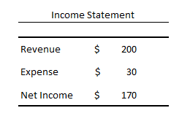
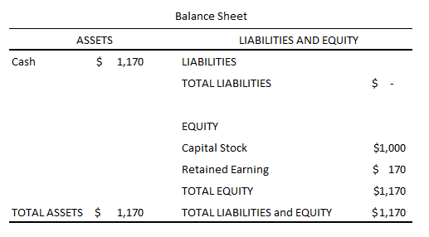
Asset vs. Expense – Example #2
ST Clean-House Consulting did two sanitizing activities and earned $100 from each activity. They were paid by cash. And they paid salary to their employees $30 by cash. And there is no other event in 2022.
May.1., 2022
Main Revenue (revenue) $100
Cash (asset) $100
June.1., 2022
Main Revenue (revenue) $100
Cash (asset) $100
June.20., 2022
Cash (asset) $30
Salary Expense (expense) $30

Slide 8
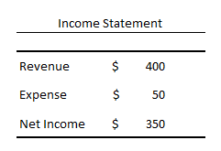
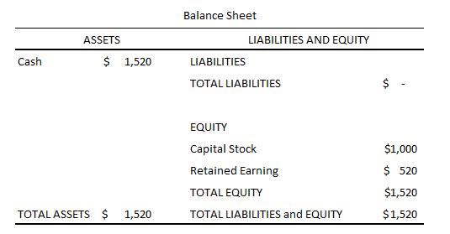
Asset vs. Expense – Example #2-1
ST Clean-House Consulting did four sanitizing activities and earned $400 from each activity. They were paid by cash. And they paid salary to their employees $50 by cash. And there is no other event in 2023.
X 4
May.1., 2023
Main Revenue (revenue) $100
Cash (asset) $100
June.20., 2023
Cash (asset) $50
Salary Expense (expense) $50

Slide 9
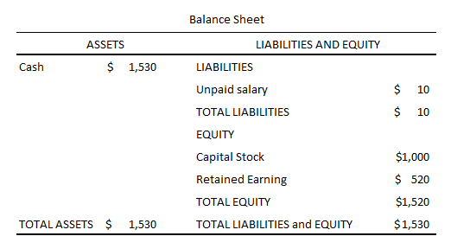
Asset vs. Expense – Example #2-2
ST Clean-House Consulting did four sanitizing activities and earned $400 from each activity. They were paid by cash. And the total salary is $50. But they paid salary to their employees 40$ by cash. And they promised that the remaining $10 will be paid next year. There is no other event in 2023.
X 4
May.1., 2023
Main Revenue (revenue) $100
Cash (asset) $100
June.20., 2023
Cash (asset) $40
Salary Expense (expense) $50
Un-paid Salary (liability) $10

Slide 10
Summary– Example #2
They paid salary to their employees $50 by cash
or
The total salary is $50. But they paid salary to their employees 40$ by cash. And they promised that the remaining $10 will be paid next year.

Slide 11
Any Questions?

Slide 12
Team Activity
Make a team with two people. Prepare income statements and balance sheets from 2021 to 2023.
- ST Clean-House Consulting was established with $1,000 of cash on Dec. 1st, 2021. And there is no other event in 2021.
- ST Clean-House Consulting did two sanitizing activities and earned $100 from each activity. Customers promised to give cash in the future. And the salary for employees was $30 but it was not paid. And there is no other event in 2022.
- ST Clean-House Consulting did four sanitizing activities and earned $400 from each activity. Customers promised to give cash in the future. And the total salary for employees is $50 but it was not paid. There is no other event in 2023.

Slide 13
Asset vs. Expense – Example #3
ST Clean-House Consulting was established with $1,000 of cash on Dec. 1st, 2021. And they bought cleaning chemical 100 liters by paying $300 cash. And there is no other event in 2021.
ST Clean-House Consulting did two sanitizing activities and earned $100 from each activity. They received cash from customers. And they paid salary to their employees $30 by cash. It spent 25 liters chemical. And there is no other event in 2022.
ST Clean-House Consulting did four sanitizing activities and earned $400 from each activity. They received cash. And they paid salary to their employees $50 by cash. It spent 40 liters chemical. And there is no other event in 2023.

Slide 14
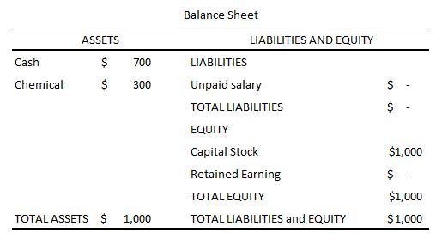
Asset vs. Expense – Example #3-1
ST Clean-House Consulting was established with $1,000 of cash on Dec. 1st, 2021. And they bought cleaning chemical 100 liters by paying $300. And there is no other event in 2021.
Dec.1., 2021
Cash (asset) $1,000
Capital Stock(equity) $1,000
Dec.1., 2021
Chemical (asset) $300
Cash (asset) $300

Slide 15
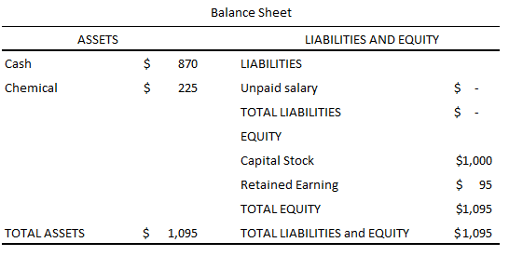
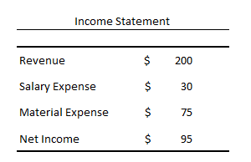
Asset vs. Expense – Example #3-1
ST Clean-House Consulting did two sanitizing activities and earned $100 from each activity. They received cash from customers. And they paid salary to their employees $30 by cash. It spent 25 liters chemical. And there is no other event in 2022.
May.1., 2022
Main Revenue (revenue) $100
Cash (asset) $100
May.1., 2022
Main Revenue (revenue) $100
Cash (asset) $100
June.20., 2022
Cash (asset) $30
Salary Expense (expense) $30
May.1., 2022
Chemical (asset) $75
Material Expense (expense) $75

Slide 16
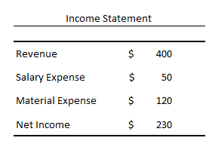
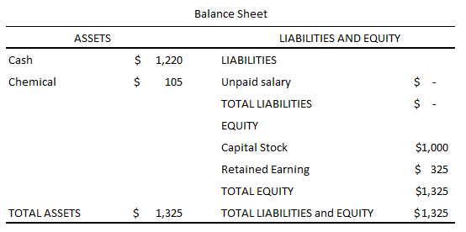
Asset vs. Expense – Example #3-1
ST Clean-House Consulting did four sanitizing activities and earned $400 from each activity. They received cash. And they paid salary to their employees $50 by cash. It spent 40 liters chemical. And there is no other event in 2023.
May.1., 2023
Main Revenue (revenue) $400
Cash (asset) $400
June.20., 2023
Cash (asset) $50
Salary Expense (expense) $50
May.1., 2023
Chemical (asset) $120
Material Expense (expense) $120

Slide 17
Any Questions?

Slide 18
Team Activity
Make a team with two people. Prepare income statements and balance sheets from 2021 to 2023.
ST Clean-House Consulting was established with $1,000 of cash on Dec. 1st, 2021. And they bought cleaning chemical 100 liters with $300. They did not pay. And there is no other event in 2021.
ST Clean-House Consulting did two sanitizing activities and earned $100 from each activity. Customers did not pay and promised that they would pay. And the $30 salary was not paid. It spent 25 liters chemical. And there is no other event in 2022.
ST Clean-House Consulting did four sanitizing activities and earned $400 from each activity. Customers did not pay and promised that they would pay. The $50 salary was not paid. It spent 40 liters chemical. And there is no other event in 2023.

Slide 19
Asset vs. Expense – Example #3-2
ST Clean-House Consulting was established with $1,000 of cash on Dec. 1st, 2021. And they bought cleaning chemical 100 liters by paying $300. And there is no other event in 2021.
Dec.1., 2021
Cash (asset) $1,000
Capital Stock(equity) $1,000
Dec.1., 2021
Chemical (asset) $300
Cash (asset) $300

Slide 20
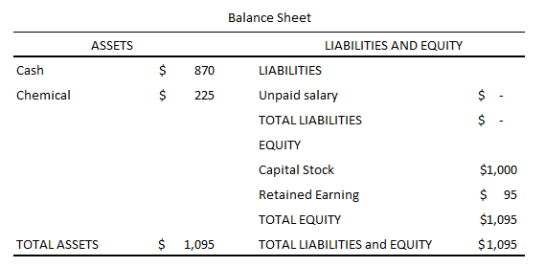
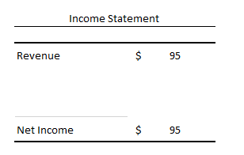
Asset vs. Expense – Example #3-2
ST Clean-House Consulting did two sanitizing activities and earned $100 from each activity. They received them by cash. And it paid salary to their employees $30 by cash. It spent 25 liters chemical. And there is no other event in 2022.
May.1., 2022
Main Revenue (revenue) $100
Cash (asset) $100
June.1., 2022
Main Revenue (revenue) $100
Cash (asset) $100
June.20., 2022
Cash (asset) $30
Main Revenue (revenue) $30
June.20., 2022
Chemical (asset) $75
Main Revenue (revenue) $75

Slide 21
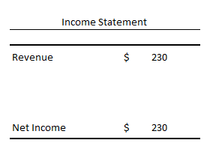
Asset vs. Expense – Example #3-2
ST Clean-House Consulting did four sanitizing activities and earned $400 from each activity. They received them by cash. And it paid salary to their employees $50 by cash. It spent 40 liters chemical. And there is no other event in 2023.
May.1., 2023
Main Revenue (revenue) $400
Cash (asset) $400
June.20., 2023
Cash (asset) $50
Main Revenue (revenue) $50
June.20., 2023
Chemical (asset) $120
Main Revenue (revenue) $120

Slide 22
Summary– Example #3
Showing the detail items in the financial statements in 2023
or
Showing the simple result in 2023
Example #3-1
Example #3-2

Slide 23
Any Questions?

Slide 24
Asset vs. Expense – Example #4
ST Gas was established with $1,000 of cash on Dec. 1st, 2021. And it bought 100 liters of gasoline to sell them in the future by paying $300 cash. And there is no other event in 2021.
ST Gas sold 30 liters of gasoline with $200 of cash. They received cash. And there is no other event in 2022.
ST Gas sold 25 liters of gasoline with $500 of cash. And ST Gas sold 10 liters of gasoline with $200 of cash. They received cash. And there is no other event in 2023.

Slide 25
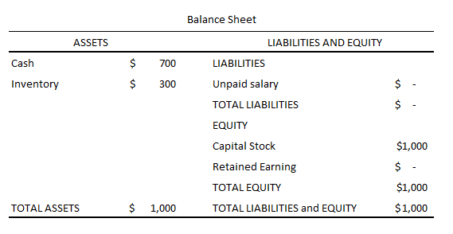
Asset vs. Expense – Example #4-1
ST Gas was established with $1,000 of cash on Dec. 1st, 2021. And it bought 100 liters of gasoline to sell them in the future by paying $300 cash. And there is no other event in 2021.
Dec.1., 2021
Cash (asset) $1,000
Capital Stock(equity) $1,000
Dec.1., 2021
Inventory (asset) $300
Cash (asset) $300

Slide 26
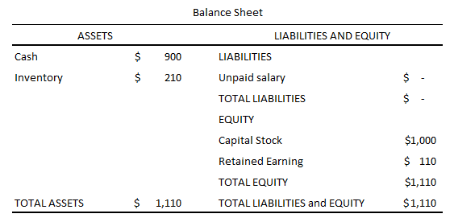
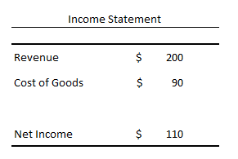
Asset vs. Expense – Example #4-1
ST Gas sold 30 liters of gasoline with $200 of cash. They received cash. And there is no other event in 2022.
May.1., 2022
Main Revenue (revenue) $200
Cash (asset) $200
May.1., 2022
Inventory (asset) $90
Cost of goods (expense) $90

Slide 27
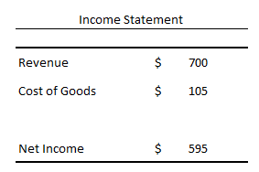
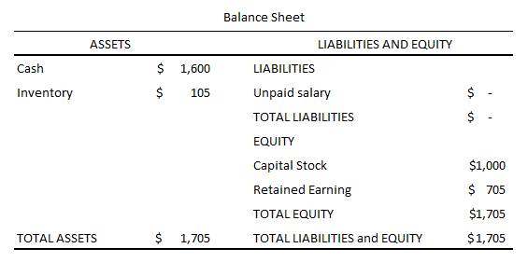
Asset vs. Expense – Example #4-1
ST Gas sold 25 liters of gasoline with $500 of cash. And ST Gas sold 10 liters of gasoline with $200 of cash. They received cash. And there is no other event in 2023.
May.1., 2023
Main Revenue (revenue) $500
Cash (asset) $500
May.1., 2023
Inventory (asset) $75
Cost of goods (expense) $75
May.10., 2023
Main Revenue (revenue) $200
Cash (asset) $200
May.10., 2023
Inventory (asset) $30
Cost of goods (expense) $30

Slide 28
Team Activity
Make a team with two people. Prepare income statements and balance sheets from 2021 to 2023.
ST Gas was established with $1,000 of cash on Dec. 1st, 2021. And it bought 100 liters of gasoline with $300. But they did not pay cash. And there is no other event in 2021.
ST Gas sold 30 liters of gasoline with $200. The customer promised to pay later. And there is no other event in 2022.
ST Gas sold 25 liters of gasoline with $500 of cash. And ST Gas sold 10 liters of gasoline with $200 of cash. Customers promised to pay later. And there is no other event in 2023.

Slide 29
Asset vs. Expense – Example #4-2
ST Gas was established with $1,000 of cash on Dec. 1st, 2021. And it bought 100 liters of gasoline to sell them in the future by paying $300 cash. And there is no other event in 2021.
Dec.1., 2021
Cash (asset) $1,000
Capital Stock(equity) $1,000
Dec.1., 2021
Inventory (asset) $300
Cash (asset) $300

Slide 30
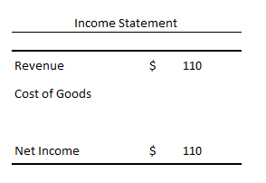
Asset vs. Expense – Example #4-2
ST Gas sold 30 liters of gasoline with $200 of cash. They received cash. And there is no other event in 2022.
May.1., 2022
Main Revenue (revenue) $110
Cash (asset) $200
Inventory (asset) $90

Slide 31
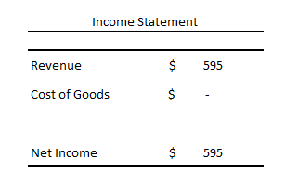
Asset vs. Expense – Example #4-2
ST Gas sold 25 liters of gasoline with $500 of cash. And ST Gas sold 10 liters of gasoline with $200 of cash. They received cash. And there is no other event in 2023.
May.1., 2023
Main Revenue (revenue) $425
Cash (asset) $500
Inventory (asset) $75
May.10., 2023
Main Revenue (revenue) $170
Cash (asset) $200
Inventory (asset) $30

Slide 32
Summary– Example #4
Showing the detail items in the financial statements in 2023
or
Showing the simple result in 2023
Example #4-1
Example #4-2

Slide 33
Any Questions?

Slide 34
Asset vs. Expense – Example #5
The main business of ST Gas is selling gasoline to customers. ST Gas bought land with $800 of cash. And it sold the land with $1,000 cash in 2023.
ST Gas sold 25 liters of gasoline with $500 of cash. And ST Gas sold 10 liters of gasoline with $200 of cash. They received cash. And there is no other event in 2023.
March.1., 2023
Cash (Asset) $800
Land (asset) $800
March.30., 2023
Cash (asset) $1,000
Land (asset) $800
Gain on land disposal (revenue) $200
May.1., 2023
Cash (asset) $500
Main Revenue (revenue) $500
May.1., 2023
Inventory (asset) $75
Cost of goods (expense) $75
May.10., 2023
Main Revenue (revenue) $200
Cash (asset) $200
May.10., 2023
Inventory (asset) $30
Cost of goods (expense) $30

Slide 35
Team Activity
Make an income statement and balance sheet for ST Gas in the year of 2023.
- The main business of ST Gas is selling gasoline to customers. ST Gas bought land with $800 of cash. And it sold the land with $1,000 cash in 2023.
- ST Gas sold 25 liters of gasoline with $500 of cash. And ST Gas sold 10 liters of gasoline with $200 of cash. They received cash. And there is no other event in 2023.

Slide 36
Any Questions?

Slide 37
Mid-term exam solution (Attendance check) (Homework #2 and online-class)

